Slide 1
Predicting Student Success and Foiling Dropout in Polytechnic Institute of Portalegre (IPP), Portugal
-Lakshmi Chirumamilla

Slide 2
Project Proposal
Targeted Problem:
How can we construct an effective predictive framework for distinguishing students likely to succeed academically from those at risk of dropping out in educational institutions.
Justification: Educational Improvements, Early Intervention
Research Question:
What strategies and techniques can be effectively employed to achieve precise predictions regarding students at risk of dropout and those on track for academic success?
Dataset:
Where does the dataset come from?- Considered Predict student’s dropout and academic success data from Polytechnic Institute of Portalegre (IPP), Portugal - Predict students' dropout and academic success - UCI Repository
Short description- The dataset includes information known at the time of student enrollment and student’s academic performance at the end of the first and second semester. Features include student demographics, academic performance, behavioural data, socioeconomic data, and historical records of dropout and academic success.
Size- #instances 4424, #Features 36
Motivation:
Technical - Developing predictive models for student dropout and academic success involves data preprocessing, feature engineering and machine learning techniques, making it technically challenging task.
Personal - Improving educational outcomes and reducing dropout rates can have a profound impact on individuals lives and society as a whole.
In summary, the project aims to leverage machine learning to predict students' likelihood of dropout and academic success using a dataset obtained from educational institutions.

Slide 3
Literature Review
Early Prediction of student’s Performance in Higher Education: A Case Study
M.V.Martins, D. Tolledo, J. Machado, L. M.T. Baptista, V.Realinho. (2021) Trends and Applications in Information Systems and Technologies, vol.1, in Advances in Intelligent Systems and Computing series. Springer. DOI: 10.1007/978-3-030-72657-7_16
Goal: Can we develop a robust predictive model for the early identification of students at risk of poor performance in the early stage of higher education?
Dataset: https://archive.ics.uci.edu/dataset/697/predict+students+dropout+and+academic+success
Methodology
Data Sampling Techniques: To address class imbalance, Synthetic Minority Over-sampling Technique (SMOTE) and Adaptive Synthetic (ADASYN) sampling methods were employed. These techniques focused on enhancing the representation of minority classes in the dataset.
Model Selection and Training: Several machine learning algorithms, such as Random Forest, Logistic Regression, Support Vector Machine, Decision Tree, Gradient Boosting, Extreme Gradient Boosting, Logit Boost, and CatBoost, were implemented and trained using the preprocessed data. Hyperparameter optimization techniques were applied to enhance the models' performance.
Results & Limitations
Extreme Gradient Boosting proved superior in predicting student outcomes compared to standard models.
SMOTE notably enhanced accuracy for minority classes, mitigating class imbalance. However, accurately predicting minority class performance remained challenging, highlighting the task's complexity.
The study's predictive models, while advanced, still faced challenges in accurately classifying students in minority categories due to the inherent complexity of imbalanced multi-class classification.
The research did not incorporate post-enrollment academic performance data, potentially limiting the models' ability to capture evolving student performance patterns.
Link - https://link.springer.com/chapter/10.1007/978-3-030-72657-7_16

Slide 4
Staying Ahead of the Curve: Early Prediction of Academic Probation among First-Year CS Students
B. M. Neda, M. Wang, A. Singh, S. Gago-Masague and J. Wong-Ma, "Staying Ahead of the Curve: Early Prediction of Academic Probation among First-Year CS Students," 2023 3rd International Conference on Applied Artificial Intelligence (ICAPAI), Halden, Norway, 2023, pp. 1-7, doi: 10.1109/ICAPAI58366.2023.10194020.
Goal: Can ML classifiers help detect CS students who may be on academic probation during their first year at UCI? Can feature analysis give meaningful insights into characteristics that may be important in the early detection of first-year academic probation status in CS students?
Dataset: Predict students' dropout and academic success - UCI Repository
Methodology
Data Preprocessing: The dataset underwent preprocessing steps, including imputation of null values, feature scaling using RobustScaler, and oversampling of the minority class using the SMOTEENN and Edited Nearest Neighbors (ENN) technique to address data imbalance.
Classification: Various machine learning classifiers, such as Logistic Regression, Random Forest, Linear Support Vector Machines, Decision Tree, Gaussian Naive-Bayes, Adaboost, Gradient Boosting, XGBoost, and KNN, were trained and evaluated using performance metrics like accuracy, recall, F1 score, and ROC AUC score.
Feature Coefficient Analysis: was performed to identify the most influential variables in predicting students' likelihood to be classified as at-risk of entering academic probation.
Results & Limitations
Logistic Regression and Linear Support Vector Machines (SVM) were the most effective classifiers, achieving high recall scores (0.812 and 0.838, respectively). Key factors included ethnicity, region, and prior programming experience (AP CS A exam). In contrast, academic variables had lesser impact, with smaller coefficients in the prediction models.
The analysis focuses solely on first-year students, overlooking complexities in later academic years, and the predictive models are built on historical data, excluding real-time influences on academic performance. The study also does not deeply explore the underlying social and economic factors contributing to demographic disparities in academic outcomes.
Link - https://ieeexplore.ieee.org/document/10194020/

Slide 5
Identification and comparison of the main variables affecting early university dropout rates according to knowledge area and institution
Llauró A, Fonseca D, Romero S, Aláez M, Lucas JT, Felipe MM. Identification and comparison of the main variables affecting early university dropout rates according to knowledge area and institution. Heliyon. 2023 Jun 17;9(6):e17435. doi: 10.1016/j.heliyon.2023.e17435. PMID: 37441382; PMCID: PMC10333612.
Goal: Which personal variables, when weighted by tutors, have the most substantial impact on the construction of an instrument measuring the risk of student dropout? Are there notable disparities in the weighting of key variables based on tutors' criteria for knowledge areas, universities, and/or regions? Could these differences significantly influence the calculation of student dropout risk?
Dataset: Predict students' dropout and academic success - UCI Repository
Methodology
Iterative Design and Questionnaire Development: Used UCD principles, involved 12 experienced tutors for variable selection and refinement. Created a preliminary 13-item questionnaire, refined to 34 weighted questions based on tutor feedback.
Scoring System: Tutors scored questions 1-10, averaged scores for question weights. Responses categorized for nuanced dropout risk understanding.
Student Participation: Administered final questionnaire to 1742 first-year students across disciplines and universities.
Results & Limitations
Identified significant differences in dropout risk when considering specific tutors' criteria compared to generic weighting. Engineering students exhibited a high risk of dropout (55.17%) under generic weighting, which increased to 69.11% with specific criteria. Law students showed a Gaussian bell curve pattern centered around high risk (60.66%).
The effectiveness of the questionnaire heavily relied on tutors' expertise, potentially introducing subjectivity in weighting decisions.Certain demographic, social, or economic factors influencing dropout rates were not deeply explored, potentially overlooking essential contextual information.
Link - https://www.cell.com/heliyon/pdf/S2405-8440(23)04643-1.pdf
https://pubmed.ncbi.nlm.nih.gov/37441382/

Slide 6
Early Predicting of Students Performance in Higher Education
E. Alhazmi and A. Sheneamer, "Early Predicting of Students Performance in Higher Education," in IEEE Access, vol. 11, pp. 27579-27589, 2023, doi: 10.1109/ACCESS.2023.3250702.
Goal: To develop an accurate predictive model that can identify students at risk of poor performance early in their higher education journey. By understanding the key factors influencing academic outcomes, this aims to enhance support systems and intervention strategies for struggling students.
Dataset: Predict students' dropout and academic success - UCI Repository
Methodology
Feature Selection and Engineering: Features such as admission scores, gender, and first-level course scores were selected and engineered for analysis. Dimensionality reduction was performed using the t-SNE algorithm to visualize the relationships between features and student performance.
Model Building: Five machine learning algorithms (Xgboost, Logistic Regression, SVM, KNN, Random Forest) were employed for predictive modeling.
Evaluation Metrics: Performance evaluation was conducted using metrics such as accuracy, precision, recall, and F1-score. Confusion matrices were utilized to gain insights into prediction accuracy and errors.
Results & Limitations
Combination of admission scores and all first-level courses scores demonstrated the highest accuracy, outperforming other feature combinations. Gender as a feature did not contribute positively to prediction accuracy when combined with admission scores.
Random Forest, SVM, and GNB classifiers exhibited the best performance across various feature combinations.
t-SNE dimensionality reduction helped visualize the relationships between different features and student performance, aiding in better understanding the data.
The study utilized several machine learning algorithms, but the complexity of the models might not be suitable for real-time applications in educational institutions with limited computational resources. Usage of the Deep learning will be helpful.
Link - https://ieeexplore.ieee.org/document/10056943

Slide 7
Multi-Class Phased Prediction of Academic Performance and Dropout in Higher Education
Martins, M.V.; Baptista, L.; Machado, J.; Realinho, V. Multi-Class Phased Prediction of Academic Performance and Dropout in Higher Education. Appl. Sci. 2023, 13, 4702. https://doi.org/10.3390/app13084702
Goal: Can machine learning techniques accurately predict students' academic performance and dropout risk early in their academic journey?
What is the most suitable phase within the first academic year for predicting students' outcomes effectively? Which features play a significant role in predicting students' performance and dropout risk?
Dataset: Predict students' dropout and academic success - UCI Repository
Methodology
Handling Imbalanced Data: Various techniques, including data-level methods (SMOTE, SVMSMOTE, RUSBoost,) algorithm-level methods (Balanced Random Forest, Easy Ensemble Classifier) to , are employed to handle the imbalanced class distribution within the datasets.
Model Selection: Fifteen different models are built using diverse algorithms, such as Random Forest and ensemble methods of the above mentioned techniques. These models are trained and evaluated using metrics like balanced accuracy and F1 score. A 10-fold cross-validation approach is utilized to ensure robustness and avoid overfitting, with the datasets being stratified to preserve class proportions.
Results & Limitations
The study's results demonstrate that the most effective models for predicting students' academic outcomes utilize Random Forest algorithms. These models perform best when incorporating strategies to address the imbalanced nature of the data, either during training or at the data level.
The effectiveness of the models heavily relies on the choice of features and algorithms, introducing subjectivity in the prediction process.
The process of data anonymization may impact the depth of analysis, as certain specific details might be lost.
Link - https://www.mdpi.com/2076-3417/13/8/4702

Slide 8
Data Balancing Techniques for Predicting Student Dropout Using Machine Learning
Mduma, N. Data Balancing Techniques for Predicting Student Dropout Using Machine Learning. Data 2023, 8, 49. https://doi.org/10.3390/data8030049
Goal: How can machine learning models effectively predict student dropout when dealing with imbalanced datasets? Which data balancing techniques yield the best results in improving prediction accuracy for student dropout?
Dataset: https://www.kaggle.com/datasets/imrandude/studentdropindia2016
Methodology
Data Balancing Techniques: Random Under Sampling (RUS), Random Over Sampling (ROS), SMOTE (Synthetic Minority Over Sampling Technique), SMOTE ENN (SMOTE with Edited Nearest Neighbor), SMOTE TOMEK are used for data balancing
Classification Models: used are Logistic Regression (LR), Random Forest (RF), Multi-Layer Perceptron (MLP)
Evaluation Metrics: Geometric Mean (Gm), F-measure (Fm),Adjusted Geometric Mean (AGm) and confusion Matrix are used.
Results & Limitations
The SMOTE ENN data balancing technique demonstrated superior performance across both datasets, followed by SMOTE TOMEK and RUS for the Uwezo dataset, and SMOTE ENN, SMOTE TOMEK, and ROS for the Indian dataset. Accurate predictions were essential for identifying at-risk students, enabling timely intervention and support strategies.
The choice of classification algorithms was limited to LR, RF, and MLP, excluding other potential models that might yield different results.
The performance metrics used, while suitable for imbalanced datasets, do not capture all aspects of model performance, and using multiple metrics is essential for a comprehensive evaluation.
Link - https://www.mdpi.com/2306-5729/8/3/49

Slide 9
View of Exploring Individual Feature Importance in Student Persistence Prediction
Tang, Z., Chen, L., & Jain, A. (2023). Exploring Individual Feature Importance in Student Persistence Prediction. Journal of Higher Education Theory and Practice, 23(6). https://doi.org/10.33423/jhetp.v23i6.5957
Goal: Comparing the predictive performance of two widely used machine learning models, logistic regression,and random forest, and usage of the SMOTE for improvement of the model performance.
Dataset - Predict students' dropout and academic success - UCI Repository
Methodology
Model Comparison: Two machine learning algorithms were employed: Logistic Regression and Random Forest Classifier. Additionally, SMOTE augmentation was applied to balance the class distribution and observe its impact on the prediction results.
Feature Analysis: Feature importance analysis was conducted using the Random Forest Classifier to identify the significant predictors of student persistence. Individual feature contributions were analyzed for specific student predictions to understand the factors influencing their success or failure.
Results & Limitations
The Random Forest Classifier outperformed Logistic Regression in predicting student persistence. SMOTE augmentation improved the prediction accuracy for minority class (dropout), but its effect on the majority class (persistence) varied.
Key influential features in predicting student persistence included curricular units, admission grade, and tuition fee status. Individualized predictions revealed specific factors affecting success or failure for individual students, providing actionable insights for intervention strategies.
Although Logistic Regression and Random Forest were compared, other advanced algorithms were not explored, potentially affecting the overall findings.
Link - https://articlegateway.com/index.php/JHETP/article/view/5957/5648

Slide 10
Predicting Student Dropout and Academic Success
Realinho, V.; Machado, J.; Baptista, L.; Martins, M.V. Predicting Student Dropout and Academic Success. Data 2022, 7, 146. https://doi.org/10.3390/data7110146
Goal: To develop machine learning models capable of classifying students into three categories: dropout, enrolled, and graduate, at the end of the normal duration of their courses. The focus is on addressing the challenge of dropout, a significant issue in higher education, and providing accurate risk estimates for early intervention and support.
Dataset: Predict students' dropout and academic success - UCI Repository
Methodology
Feature Importance Analysis: Utilized Permutation Feature Importance technique to identify crucial features for machine learning models. Identified significant attributes such as “Curricular units 2nd sem (approved)”, “Curricular units 1st sem (approved)”, and “Course” using machine learning algorithms like Random Forest, Extreme Gradient Boosting, Light Gradient Boosting Machine, and CatBoost.
Model Development: Formulated the problem as a three-category classification task (dropout, enrolled, and graduate) at the end of the normal course duration. Developed machine learning models, possibly leveraging techniques such as ensemble methods and boosting algorithms, to predict student outcomes based on the identified features.
Results & Limitations
Identified crucial features for predicting student outcomes, including attributes related to approved curricular units, course, and tuition fee payment status.Developed machine learning models capable of classifying students into dropout, enrolled, and graduate categories, providing a basis for early intervention strategies.Achieved promising results in terms of accuracy, precision, recall, and F1-score, demonstrating the efficacy of the developed models.
Addressing imbalanced classes is challenging; while techniques like F1-score help, they might not completely mitigate bias in predictions.Although feature importance analysis was performed, the dataset might contain latent features not considered, impacting the comprehensiveness of the models.
Link - https://www.mdpi.com/2306-5729/7/11/146

Slide 11
Midterm

Slide 12
Predicting Student Success and Foiling Dropout in Polytechnic Institute of Portalegre (IPP), Portugal
-Lakshmi Chirumamilla

Slide 13
Abstract
The increasing concern regarding student dropout rates in educational institutions prompts the exploration of predictive analytics to identify students at risk and facilitate timely interventions. This project presents a novel predictive framework using machine learning (ML) techniques to distinguish students likely to succeed academically from those at risk of dropping out. Leveraging a comprehensive dataset obtained from the Polytechnic Institute of Portalegre (IPP), Portugal, encompassing student demographics, academic performance, behavioral patterns, and socioeconomic factors. The results show that the Random forest performs better than XGBoost, Logistic regression , SVM, Decision Tree, Naive Bayes. Used SHAP analysis for finding best parameters and Fine-tune the models accordingly.

Slide 14
Research Question
What strategies and techniques can be effectively employed to achieve precise predictions regarding students at risk of dropout and those on track for academic success?

Slide 15
Literature Review
In [1] and [2], extensively explores predictive analytics using machine learning models. These studies emphasize the persistent challenge of class imbalances in student datasets, addressed through innovative techniques like SMOTE and its variants to rectify skewed class distributions and enhance predictive accuracy [4].
Evaluation metrics such as precision, recall, F1-score, and AUC-ROC play pivotal roles in gauging model performance, revealing insights into student persistence and dropout rates. This collectively emphasize the evolution of predictive analytics, stressing the need to address class imbalances and emphasizing the critical roles of algorithm selection and nuanced evaluation metrics in predicting student success and dropout likelihood in higher education. There is a shortage of Hyperparameter tuning of the ML models in context of this work.

Slide 16
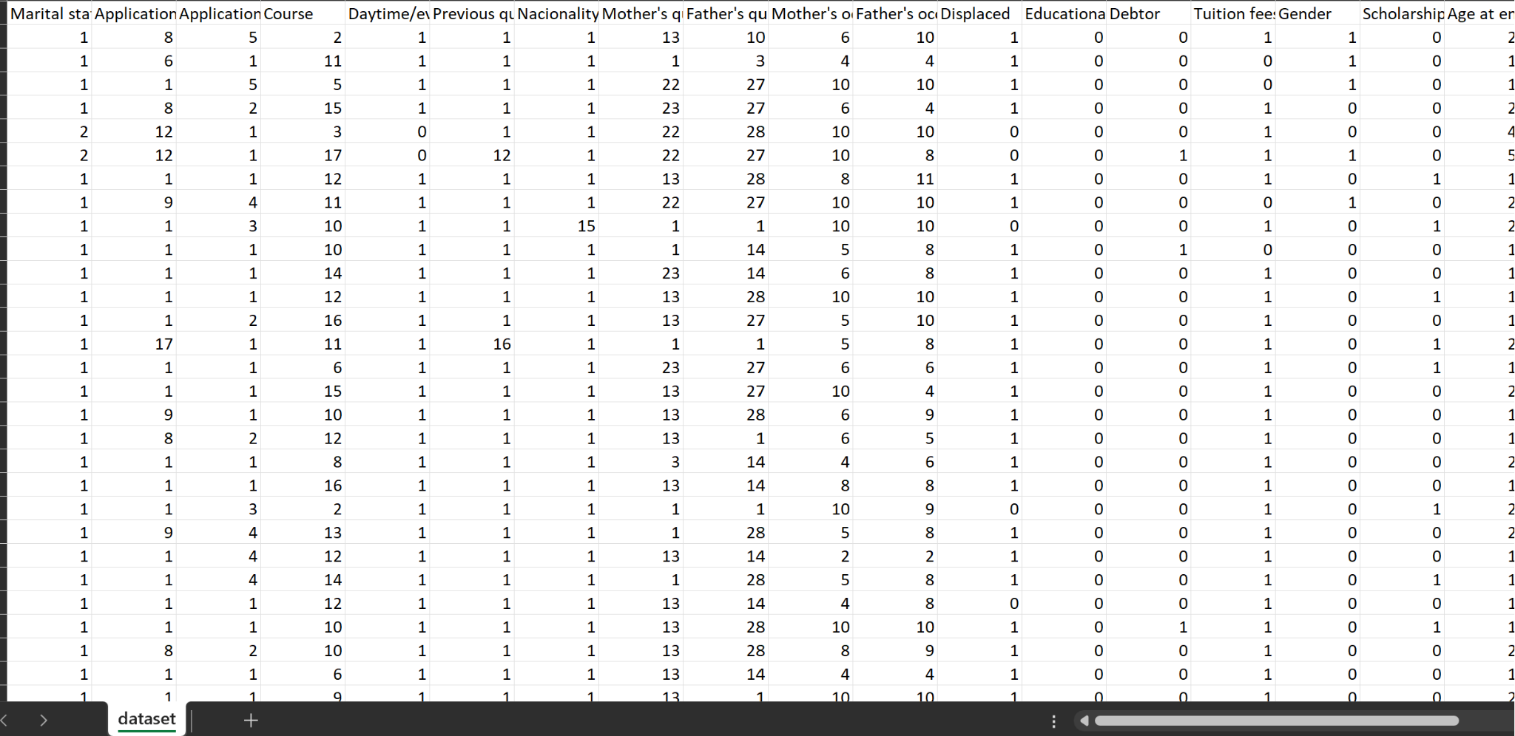
Dataset
https://archive.ics.uci.edu/dataset/697/predict+students+dropout+and+academic+success
A dataset created from a higher education institution related to students enrolled in different undergraduate degrees, such as agronomy, design, education, nursing, journalism, management, social service, and technologies. The dataset includes information known at the time of student enrollment (academic path, demographics, and social-economic factors) and the students' academic performance at the end of the first and second semesters.
Size- #instances 4424, #Features 36
Parameters - Marital status; Application mode; Application order; Course; Previous qualification; Nationality; Mother's qualification; Father's qualification; Mother's occupation; Father's occupation; Admission grade; Debtor; Tuition fees up to date; Gender; Scholarship holder; Age at enrollment; Curricular units 1st sem (grade); Curricular units 2nd sem (grade);

Slide 17
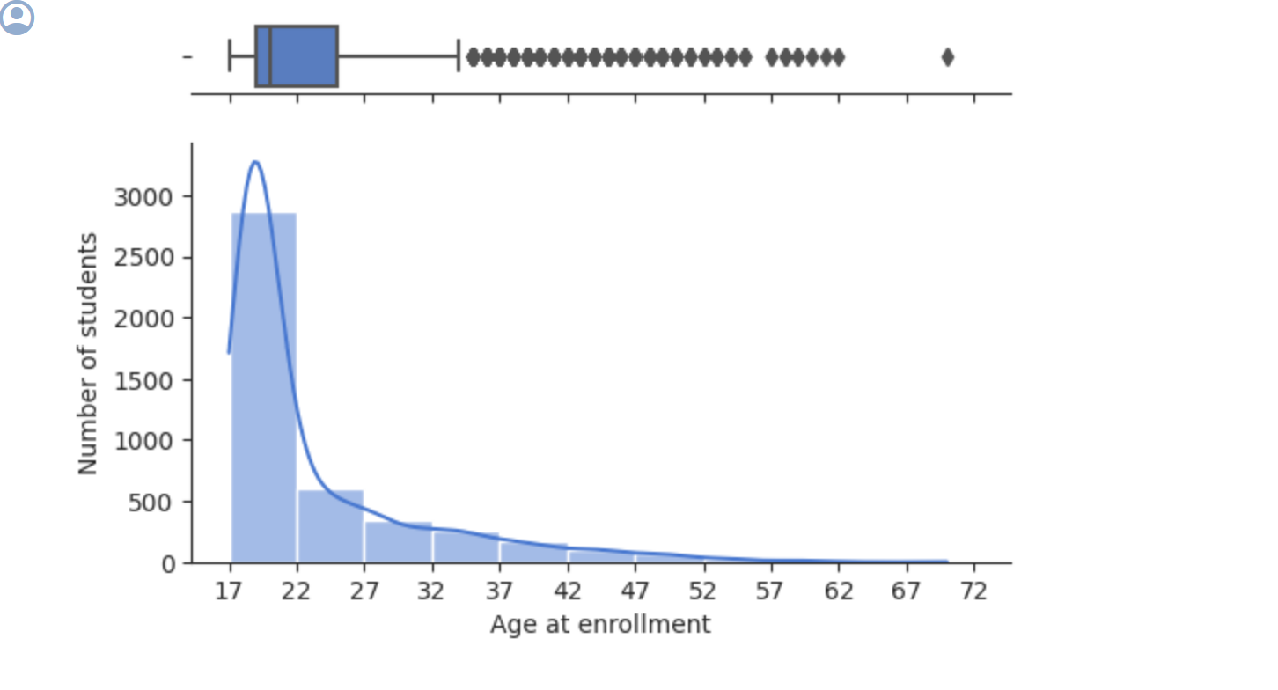
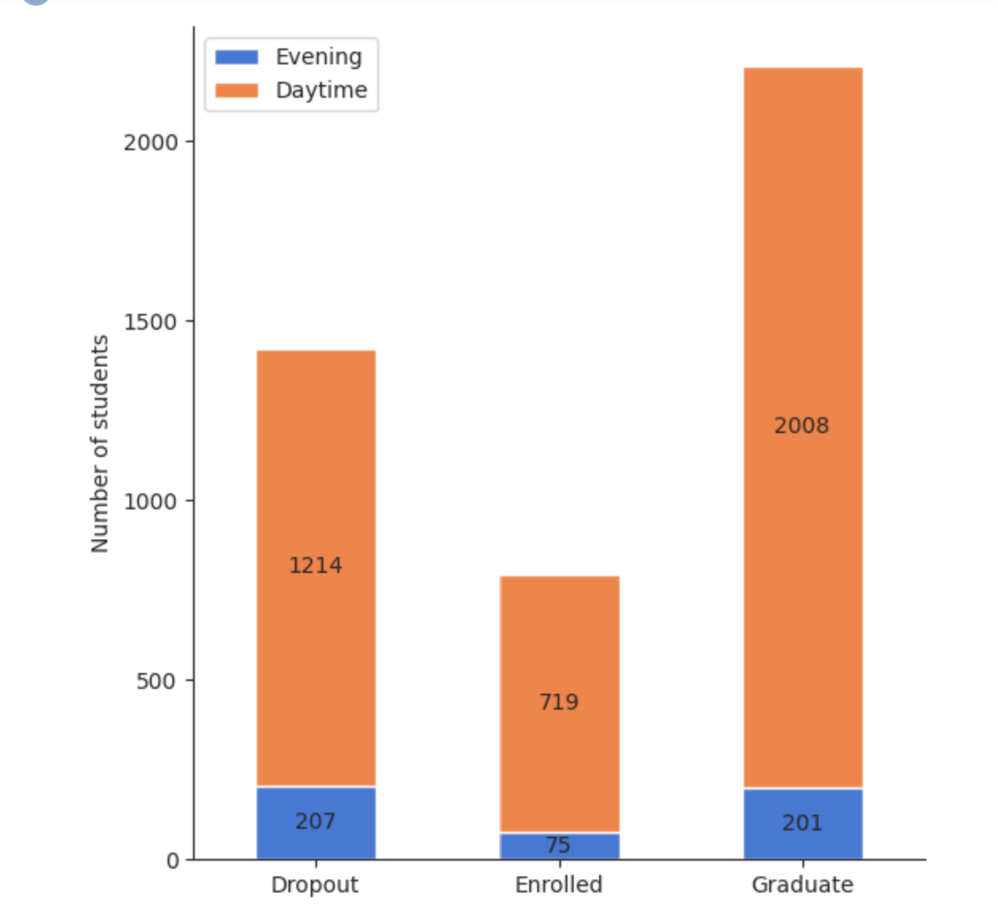
EDA
The vast majority of students are 17-22 years old.
The number of students decreases as the students age increases.
The graduation rate of daytime students is higher than the graduation rate of evening students, it is 62% against 49%. The difference is not significant.

Slide 18
Methodology
Data Balancing:
Address class imbalances using techniques like SMOTE, SMOTEENN, or ADASYN to create a more balanced dataset.
Experiment with different balancing methods to evaluate their impact on model performance.
Model Selection and Training:
Implement a variety of machine learning algorithms, including Random Forest, Gradient Boosting, Logistic Regression, and Neural Networks.
Split the dataset into training, validation, and test sets for model training and evaluation.
Apply hyperparameter tuning techniques like grid search or Bayesian optimization to optimize model performance.
Evaluation Metrics and Interpretability:
Utilize a range of evaluation metrics such as accuracy, precision, recall, F1-score, and area under the ROC curve (AUC-ROC) to assess model performance.
Conduct SHAP (SHapley Additive exPlanations) analysis to interpret the model predictions and understand the impact of individual features on outcomes.
Use confusion matrices to understand prediction errors and identify areas of improvement.

Slide 19
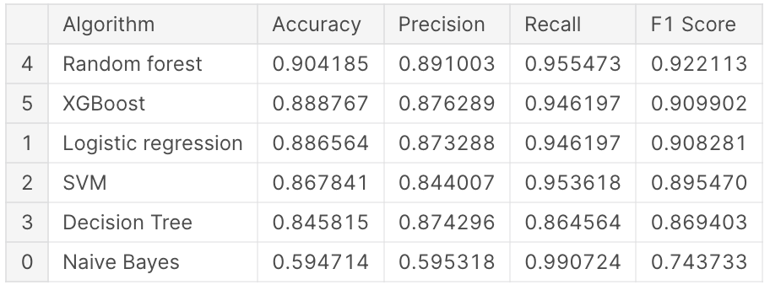
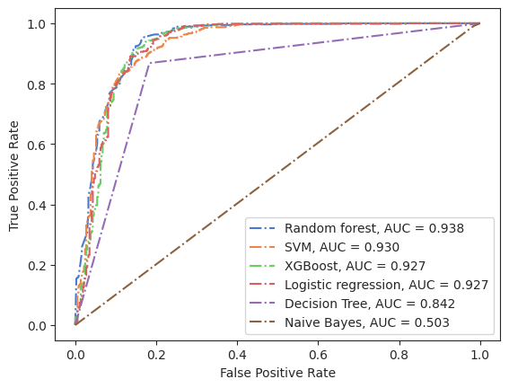

Slide 20
Next Steps
Model Fine-Tuning:
Fine-tune the selected models based on SHAP analysis and other evaluation results.
Experiment with ensemble techniques to combine the strengths of multiple models for more robust predictions.
Visualization and Real-time Integration:
Develop visualizations based on SHAP values to present the interpretability of the model predictions to stakeholders.
Explore the integration of the predictive model into existing academic support systems for real-time intervention strategies.
Develop a user-friendly interface for stakeholders to interpret model predictions and take proactive measures.

Slide 21
Results
The performance of six machine learning algorithms—Logistic Regression, SVM, Decision Tree, Naive Bayes, Random Forest, and XGBoost-was assessed for a classification task. Initial evaluation without hyperparameter tuning revealed varied performance metrics. Notably, Random Forest outperformed others with an accuracy of 90.42%, precision of 89.10%, recall of 95.55%, and F1 score of 92.21%. Subsequently, hyperparameter tuning using GridSearchCV for the Random Forest model. This refinement resulted in a marginal improvement, maintaining the accuracy at 90.42% while enhancing precision, recall, and F1 scores to 89.10%, 95.55%, and 92.21%, respectively. These findings highlight the initial strength of Random Forest and the limited impact of hyperparameter tuning on its performance in this specific classification task. Using SHAPley, the Circular units of 1st and 2nd semester have the most impact on the ML model.

Slide 22
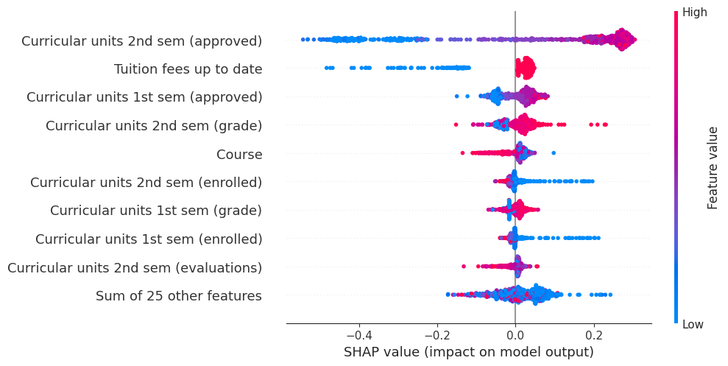

Slide 23
Conclusion
The study investigated the use of machine learning (ML) tools to predict the academic performance of first-year computer science (CS) students and identify key factors affecting their success. It found that Random Forest classifiers were effective in this prediction task. While previous work centered on GPA-based performance prediction, focusing on academic probation status allows for aiding struggling students beyond just those with low grades.
Future steps proposed involve leveraging Natural Language Processing (NLP) to analyze text materials from college applications.

Slide 24
References
M.V.Martins, D. Tolledo, J. Machado, L. M.T. Baptista, V.Realinho. (2021) Trends and Applications in Information Systems and Technologies, vol.1, in Advances in Intelligent Systems and Computing series. Springer. DOI: 10.1007/978-3-030-72657-7_16
B. M. Neda, M. Wang, A. Singh, S. Gago-Masague and J. Wong-Ma, "Staying Ahead of the Curve: Early Prediction of Academic Probation among First-Year CS Students," 2023 3rd International Conference on Applied Artificial Intelligence (ICAPAI), Halden, Norway, 2023, pp. 1-7, doi: 10.1109/ICAPAI58366.2023.10194020.
Llauró A, Fonseca D, Romero S, Aláez M, Lucas JT, Felipe MM. Identification and comparison of the main variables affecting early university dropout rates according to knowledge area and institution. Heliyon. 2023 Jun 17;9(6):e17435. doi: 10.1016/j.heliyon.2023.e17435.
E. Alhazmi and A. Sheneamer, "Early Predicting of Students Performance in Higher Education," in IEEE Access, vol. 11, pp. 27579-27589, 2023, doi: 10.1109/ACCESS.2023.3250702
Martins, M.V.; Baptista, L.; Machado, J.; Realinho, V. Multi-Class Phased Prediction of Academic Performance and Dropout in Higher Education. Appl. Sci. 2023, 13, 4702. doi: 10.3390/app13084702
Mduma, N. “Data Balancing Techniques for Predicting Student Dropout Using Machine Learning.” 2023, 8, 49. doi:10.3390/data8030049
Tang, Z., Chen, L., & Jain, A. (2023). Exploring Individual Feature Importance in Student Persistence Prediction. Journal of Higher Education Theory and Practice, 23(6). doi:10.33423/jhetp.v23i6.5957
Realinho, V.; Machado, J.; Baptista, L.; Martins, M.V. Predicting Student Dropout and Academic Success. Data 2022, 7, 146. doi: 10.3390/data7110146

